Slide 1
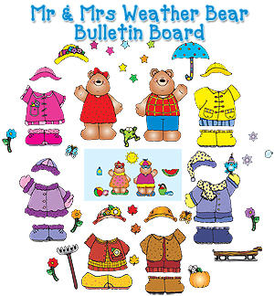
Weather. Clothes

Slide 2
Тема Погода. Одяг.
Тип уроку: комбінований (урок засвоєння нових знань та формування вмінь та навичок)
Цілі:
Практична: Навчити учнів лексиці з теми, тренувати вживання вивченої лексики в усному мовленні та на письмі;
Розвиваюча: розвивати навички читання, письма, аудіювання та говоріння, розвивати мовну здогадку та мовленнєву реакцію, увагу, пам’ять, логічне та творче мислення учнів;
Виховна: виховувати ввічливість та культуру поведінки , естетичний смак;
Освітня: розширити словниковий запас учнів, поглибити знання учнів з теми, підвищити мотивацію вивчення англійської мови;
Обладнання: підручники, зошити, мультимедійна презентація, малюнки, роздаткові матеріали, аудіо та відеоматеріали.

Slide 3
План уроку
Початок уроку - 5 хв.
1.Фонетична розминка
2.Мовленнєва розминка
Основна частина уроку
Введення та семантизація лексики;- 5хв.
Лексичні вправи: - 10 хв.
а) опрацювання графічного образу;
б) опрацювання значення слова;
3. Навчання аудіюванню – 5 хв.
4. Навчання читанню - 6 хв.
5. Навчання письму - 5 хв.
6. Навчання говорінню – 5 хв.
Заключна частина уроку. - 3хв.
Підведення підсумків уроку. Виставлення оцінок.
Домашнє завдання
autumn

Slide 4

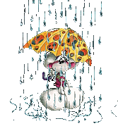
Read the poem, mind your sounds and intonation, please
The sun is shining
And I am smiling,
The weather is bad
And I am sad.
When it is dry
We are fine…
The weather is nice,
Isn’t it a surprise?

Slide 5
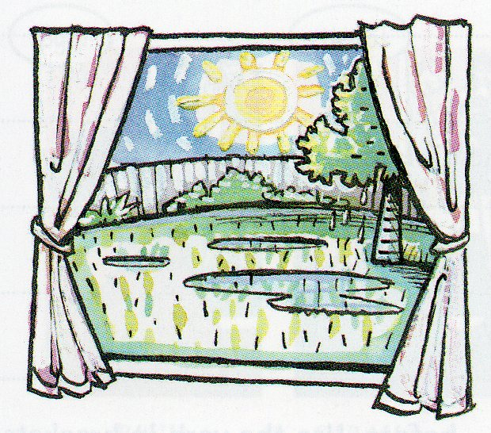
What’s
the weather like?

Slide 6
It’s sunny

Slide 7
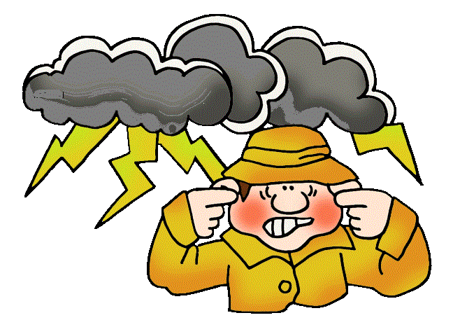
It’s stormy

Slide 8

It’s cloudy

Slide 9
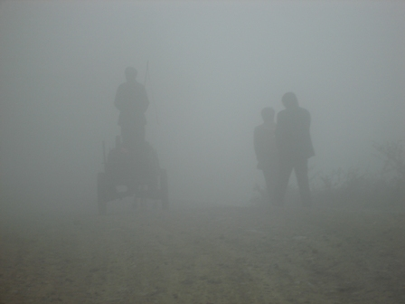
It’s foggy

Slide 10
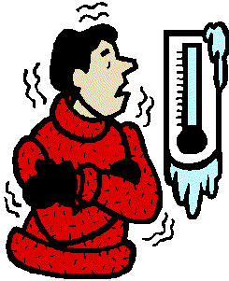
It’s freezing cold

Slide 11
It’s hot

Slide 12
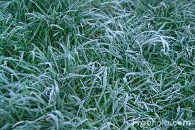
It’s frosty

Slide 13
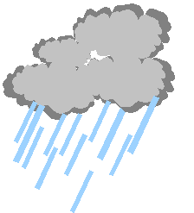
It’s raining

Slide 14
It’s snowing

Slide 15
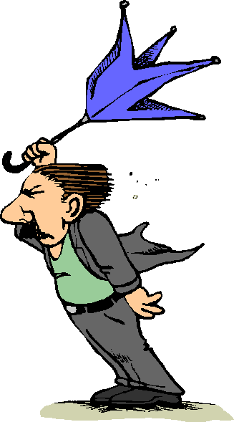
It’s windy

Slide 16
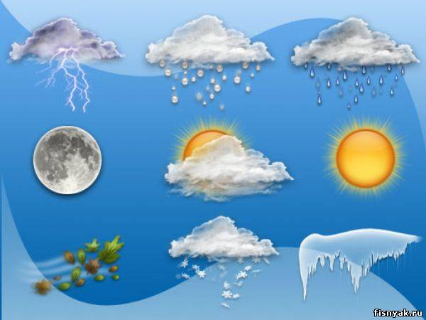
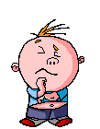
It’s ... today.

Slide 17
What weather do you like/dislike ?
I like when the weather is…
(cold, sunny, warm, cool, hot, frosty, snowy, rainy, stormy, foggy, wet, windy, cloudy)
I dislike the weather with…
(a lot of snow, a lot of sunshine, a cold wind, a thick fog, thunder and lightning, a heavy shower)

Slide 18
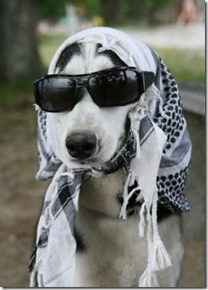
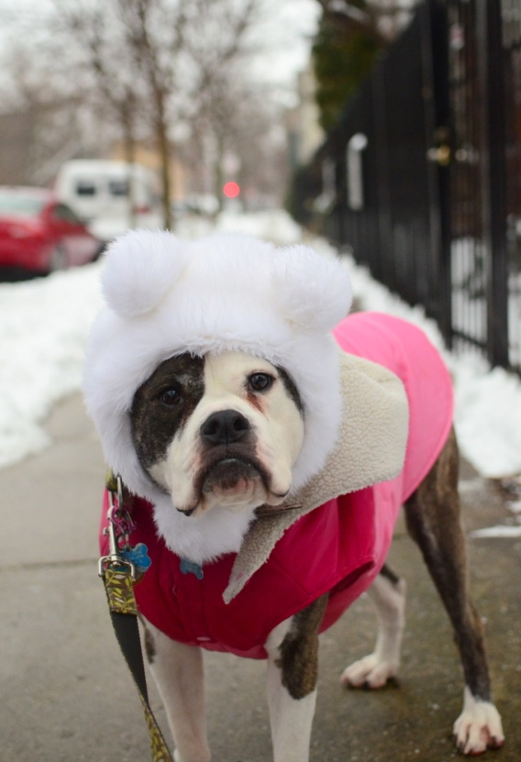
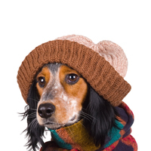
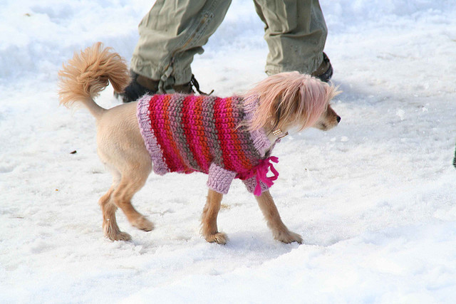
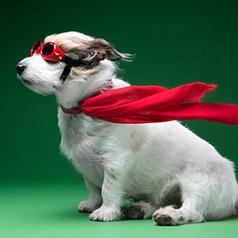
There is no bad weather – there are bad clothes.

Slide 19

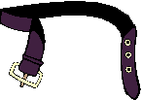
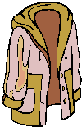

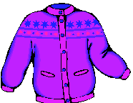

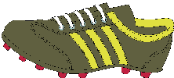
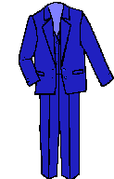
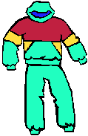

Slide 20

a belt

Slide 21
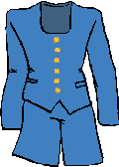
a suit

Slide 22
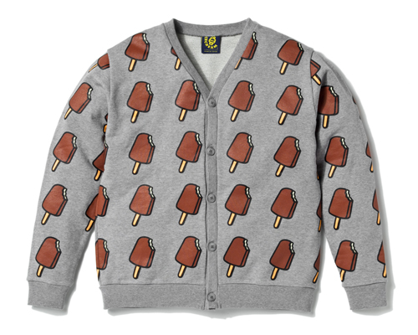
a cardigan

Slide 23
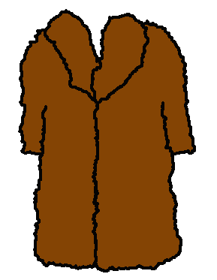
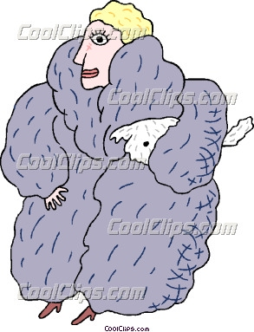
a fur coat

Slide 24
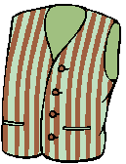

a waistcoat

Slide 25
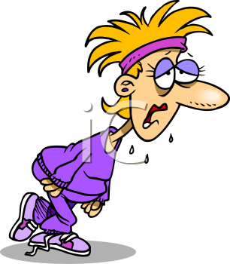
a tracksuit

Slide 26

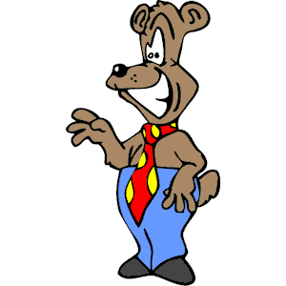
a tie

Slide 27
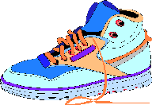
trainers

Slide 28

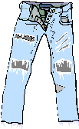
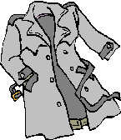

1
2
3
a) a tie
b) trainers
c) a tracksuit
d) a suit
e) a fur coat
f) a belt
a cardigan
a raincoat
jeans
mittens
4
6
5
7
8
10
9

Slide 29
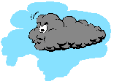
su.t
t . e
c . rdigan
tr . iners
Wa .stco . t

Slide 30
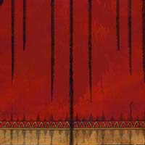
Girls and boys can wear cardigans
when it is chilly.

Slide 31
Men often wear suits .

Slide 32
You can wear a belt
with a skirt, dress or trousers.

Slide 33
A businessman usually wears a tie with a shirt.

Slide 34
Women like wearing fur coats in winter.

Slide 35
For our PE classes we usually wear tracksuits and trainers .

Slide 36
Pupils of our school
wear waistcoats as
their uniform.

Slide 37
Let’s write our words. Watch carefully because they will flash on the screen for just a moment.

Slide 38
a waistcoat

Slide 39
a tie

Slide 40
a tracksuit

Slide 41
trainers

Slide 42
a cardigan

Slide 43
a fur coat

Slide 44

GREAT JOB!

Slide 45
Menswear | Ladieswear | Accessories | Footwear
raincoat
coat
boots
sunglasses
trainers
belt
suit
umbrella
scarf
cap
hat
shoes
jeans
jumper
gloves
jacket
tie
trousers
fur coat
blouse
T-shirt
sandals
shirt
socks
shorts
skirt
tracksuit
cardigan
waistcoat

Slide 46
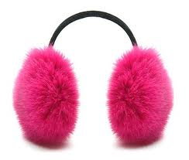

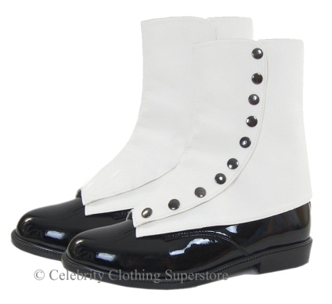
Whatever the weather is today
Will tell me what to wear if I go out to play
The temperature outside could be ____________or cold
Foggy, smoggy, freezy, breezy, _____________with a storm
Do I need a coat?
Do I need some boots?
Do I need some ___________ or a bathing suit?
I’ve got shorts and sweaters, earmuffs too
Goggles, _____________, lots of hats,
Even have my Grandpa’s spats
Whatever the weather is today
Will tell me what to wear if I go out to play
The temperature outside could be warm or cold
_____________, smoggy, freezy, breezy, rainy with a storm
Do I need a coat?
Do I need some boots?
Do I need some mittens or a bathing suit?
I’ve got shorts and_________________, earmuffs too
Goggles, sandals, lots of hats,
Even have my Grandpa’s spats
Whatever the weather is today
Will tell me what ________________if I go out to play
The temperature outside could be warm or cold
Foggy, smoggy, freezy, breezy, rainy with a storm
earmuffs
spats

Slide 47
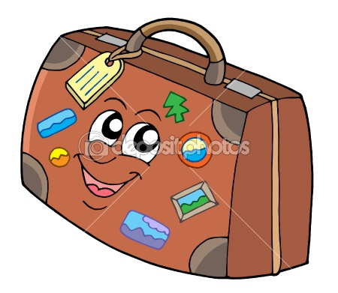
Snowy
Rainy
Sunny
Freezing cold
A bit chilly
Windy
Hot
Warm

Slide 48


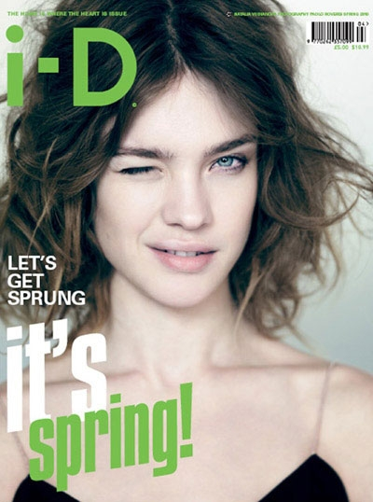
Spring
Snow melts, nature awakens from its winter sleep, and the first flowers appear.
As the weather is often changeable in this season, we offer you to mix different kinds of clothes.
If it’s a sunny but a bit chilly day, you can wear a light jacket or a trench coat, shoes, jeans and a shirt or a blouse.
Long, colourful skirts are the most popular ones in the first warm days.
The colours, we are sure to be in fashion, are bright green and blue.
Follow our tips and you’ll be an up-to-date person.

Slide 49

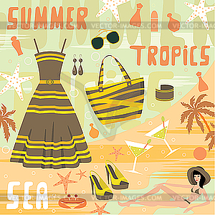
Summer
School finishes, holidays start, days get longer.
We can go on holidays, go to the beach, sunbathe, swim and eat ice-cream.
Designers are so kind with us to make shorts very popular in this time of the year.
Sometimes it’s boiling hot and we can’t think of anything but going to the sea.
Multicoloured tops, mini-skirts and light dresses are must haves.
But when men go to work they put on a suit, a shirt and a tie. Women put on a skirt and a blouse.

Slide 50

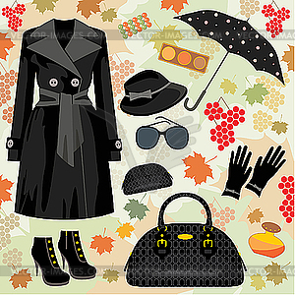
Autumn
It gets colder, days get shorter.
Indian summer comes, leaves have beautiful colours, and trees shed their leaves.
It rains a lot, and school starts.
To be fashionable wear a black coat and a woolen hat.
Grey raincoats are this season’s biggest trends, because the weather is rainy.
Don’t forget about a transparent umbrella to enjoy the rainy sky.

Slide 51

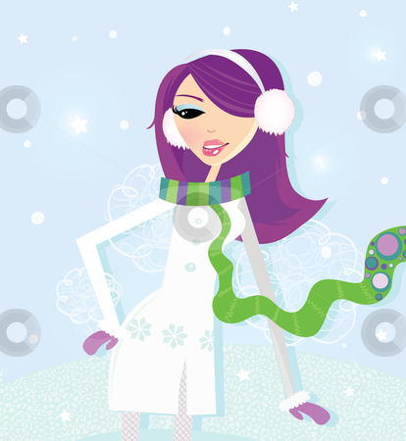
Winter
The first frosts come.
The roads are icy and slippery.
Sometimes it’s windy and freezing cold.
But it’s possible to be up-to-weather and fashionable at the same time.
One thing that every girl needs in her wardrobe is a dark red or purple scarf.
Put on high boots and a fur coat and you’ll look as a magazine model.

Slide 52
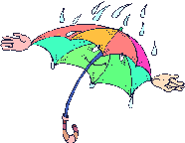




Fashion Tips
Wear brightly coloured clothes this autumn. In a red hat, red scarf and orange boots you’ll always be in a good mood. When the weather is rainy you can wear a dark blue raincoat and a take a large umbrella with you. You’ll look smart in a striped cardigan and nice jeans, too.

Slide 53

Wе’ll weather the weather,
Whatever the weather,
Whether we like it or not

Slide 54




Thank you for your attention!

